Slide 1
Presentation On Project Report
Connect To Care

Slide 2

Group No : 4 ( First Movers)
1. Saikumar N. Padige - 220360520043
2. Saurabh N. Kulkarni – 220360520046
3. Hanumant D. Borade – 220360520018
4. Vipul P. Patil – 220360520057
5. Sachin A. Warhade - 220360520041
6. Lalna L. Barhate – 220360520026
Guided By : Shobana Devi

Slide 3
Contents
Introduction
Project Requirement
ER Diagram
Schema Diagram
Technology's used in project
User Roles And Responsibilities
Future extensions or scope
Conclusion

Slide 4
Introduction
This document explains the system requirements and scope for developing the Hospital Recommendation System. The system will be used as the application that serves hospitals, clinics, dispensaries or other health institutions. The intention of the system is to increase the number of patients that can be treated and managed properly.
Patients can search and book doctor’s appointments easily based on their location, availability, and specialty. Also, hospitals can manage their doctors and patients’ records. Hospital Recommendation System could be divided into the three main parts, Patient part, Doctor part and Admin part. This document describes the system requirements.

Slide 5
Project Requirement
Hardware Requirement
Intel i3 processor or higher
RAM 4GB
500 GB HDD (Hard Disk)
Software Requirement
Web Browser: Google Chrome
Documentation: MS World
Project Presentation: MS Power Point
Platform
Windows 10/Mac/Linux

Slide 6
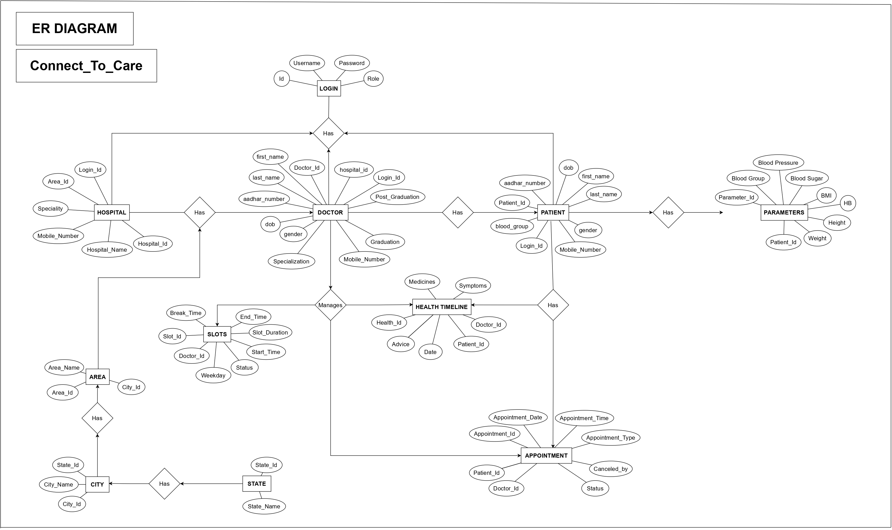
ER Diagram

Slide 7
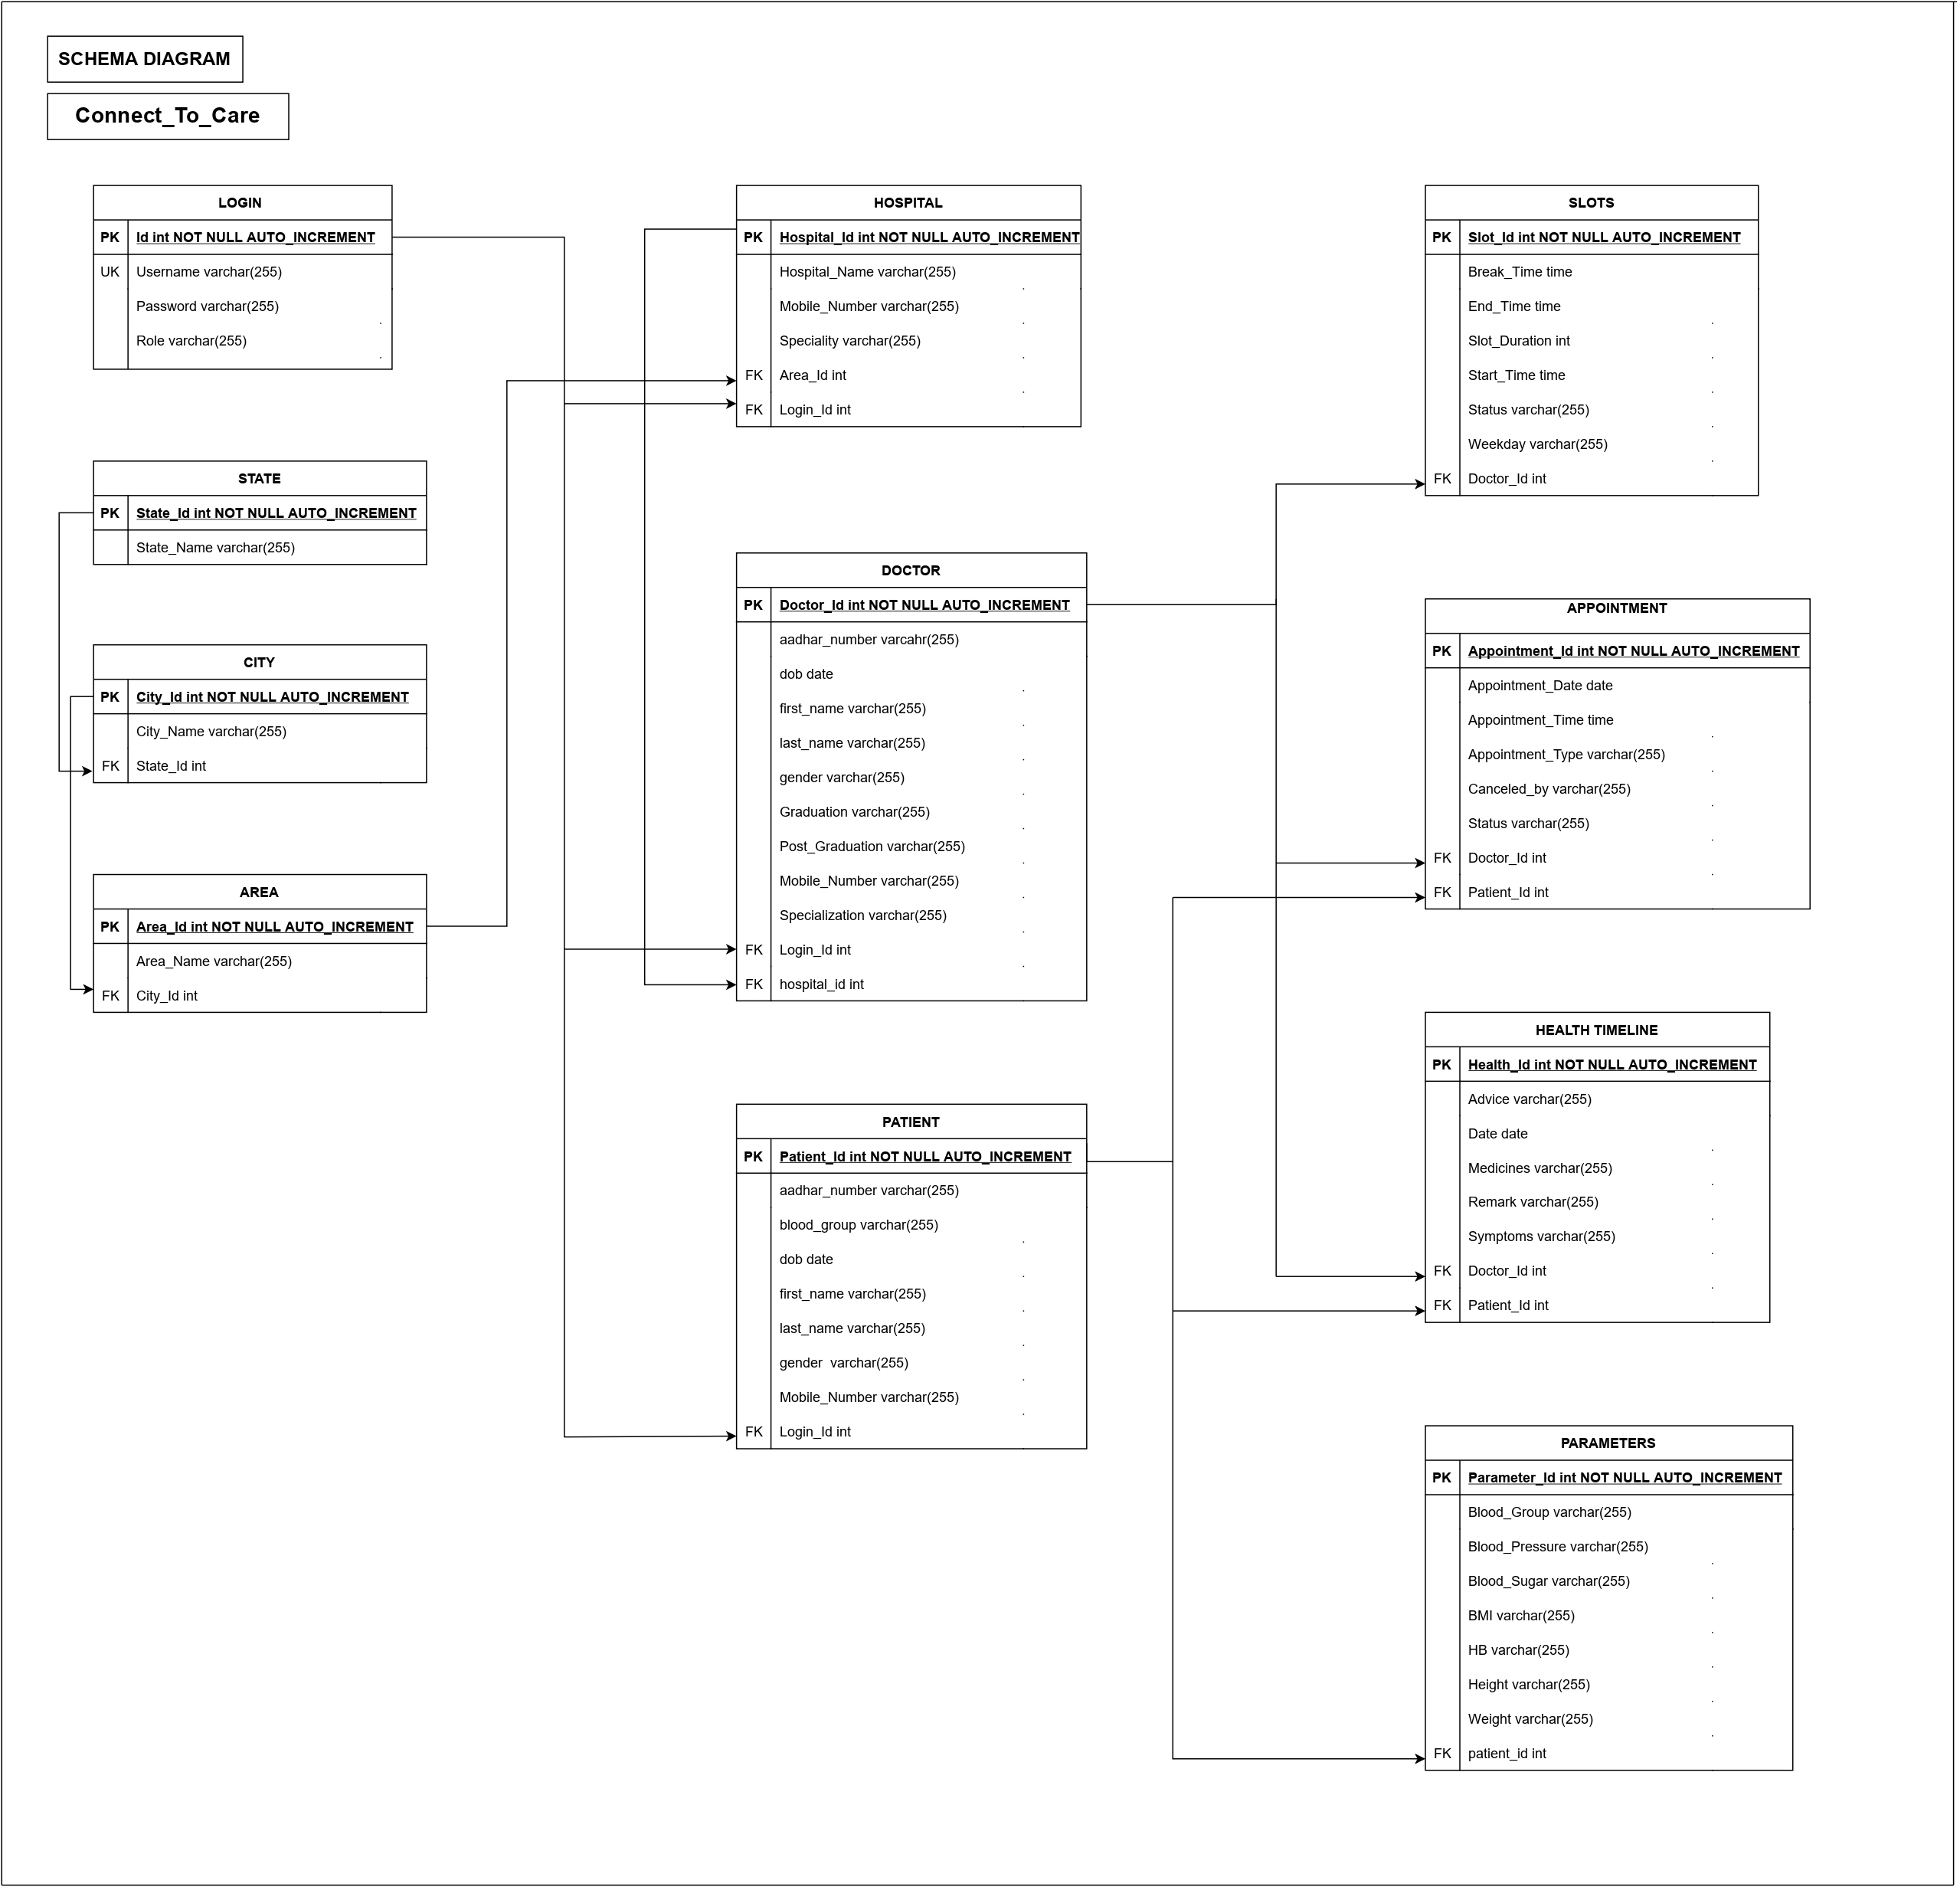
Schema Diagram

Slide 8
Technology's used in project
Front-end : ReactJS 18.2.0(HTML, CSS, Bootstrap, JavaScript)
Back-end : Spring Boot using Java8, Hibernate
Database : MySQL8
Tool used : Postman, Visual Studio Code, MySQL Workbench, Eclipse

Slide 9
User Roles And Responsibilities
Admin
Hospital
Doctor
Patient

Slide 10
Admin
Login
Hospital Records
Doctor Records
Patient

Slide 11
Hospital
Register
Login
Update Hospital Profile
Add New Doctor
Add New Patient
View Doctor List

Slide 12
Doctor
Register
Login
Create Slot’s
Update Slot’s
Scheduled Appointment
Cancel Appointment
View Appointment History
Update Profile
Health Timeline
Forgot Password

Slide 13
Patient
Register
Login
Search Hospital
Book Appointment
View Appointment
Cancel Appointment
Update Parameters
Add Parameter
Update Profile
View Health Timeline
Forgot Password

Slide 14
Future extensions or scope
We can add Online Consultation and online fee payment
Home visit of doctor
Adding Blood Bank
Pathology (Home Service)

Slide 15
Conclusion
Internet is changing the world. Though it is not possible to entirely switch the healthcare sector to online mode. But definitely it can help in bridging the gap between Patient and Doctor.
Our project Connect To Care serves the purpose of bridging the gap. It makes easy for the patient to search for the doctor in his/her locality or in any other locality. Addition to this patient can also search for the doctor based on the doctor’s specialty

